Slide 1
I am a Rhinoceros By Keith L.
I’m a rhinoceros in the dessert. I am as tough as a rhinoceros getting hit by other animals.
I’m a rhinoceros bulldozing its prey when I play football.
I’m a rhinoceros tracking down the gazelles.
I’m a rhinoceros with enormous skin.
I am a rhinoceros in the desert.

Slide 2
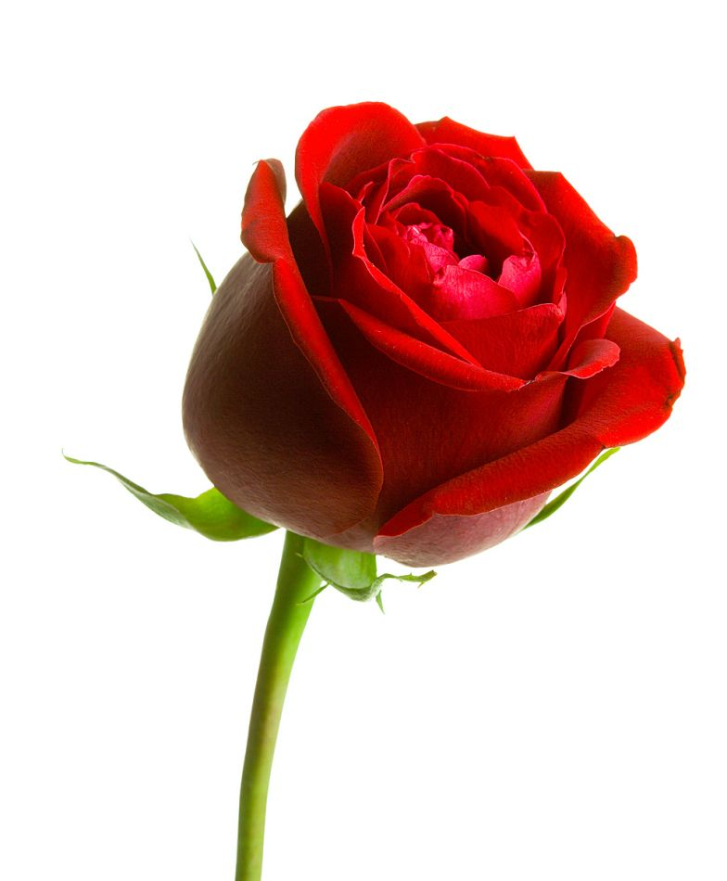
I am a Red Rose By Emilly A.
I am a red rose in a garden. My skin is beautiful pink rose petalS. I am sprouting like a tall rose.
I get as red as a Valentine’s Day rose when I’m indigent.
Like a rose, I always get filthy when I play in the soil or mud.
Everybody places me to be beautiful on their glass window to look like I am wearing a red pretty velvet dress.
I am a red rose in a garden.

Slide 3
I am a Lion By Jose P.
I am a lion hiding in tall grass when playing cops and robbers with my friends.
I am a lion hunting for food in the cabinets as well in the refrigerator.
I am a lion, energetic at day and active at night.
I am a lion roaring at daylight.
I am a proud strong lion.

Slide 4
I am a Cheetah By Kiara B.
I am a cheetah running after its prey as I run down the race track.
I am a brave cheetah hunting on its own as I prepare to go to fifth grade without fear.
I am a cute cheetah that uses it skills to get everything it wants.
I am a stalking cheetah waiting for my dinner.

Slide 5
I am a Megalodon Shark By Chris L.
I am a megalodon shark.
When I am hungry, I devour every fish I see.
When I sway back and forth, I knock down every fish that passes me.
OOHH, a fish!
I gobble it down in one bite and you can see the bone all ready.

Slide 6
I am a Golden Retriever By Kelly T.
I am a Golden Retriever.
I bark thunderously when I am mad.
I energetically play with my cousins.
When I am tired, I curl up quietly, snuggling in my bed.
When I am mischievous, I don’t listen to my parents.
I follow people around when I’m bored.
I like to have fun with water.
I like to play ball outside.
I am a Golden Retriever playing outside.

Slide 7
I am a Leopard By Victor M.
I am a leopard who is almost always quiet when I`m alone.
When it comes to chips, I am as fast as a pouncing leopard attempting to catch prey.
I am a nocturnal prowler sneaking into the snack cupboard.
I am a nocturnal, fast, and sneaky leopard.

Slide 8
I am a Ninja By Shane H.
I am a ninja going into an enemy’s stronghold.
The elements help me sneak in.
I cooperate in a team to scale a wall.
I have many ways to infiltrate.
I am the ninja sneaking around the stronghold.
I am as lethal as a ninja with a poison dart.
I am a good katana welder.
I stay focused on the mission.

Slide 9
I am a Cheetah By Nathan F.
I am a cheetah running 70 miles per hour. I am digging through the cabinets hungry as a cheetah. I am a cheetah climbing a tree trying to get its prey. When I am bored I am a cheetah running through the savannah.

Slide 10
I am a Rhino By Mason A.
I am a rhino when I get mad and run into things.
I am fast when I chase my friends in a game of tag, like a rhino chasing its prey.
I am scary when I jump out of nowhere and tackle them, like a rhino attacking an animal.
When I am really hungry, I eat sloppy like a rhino eating a deer.

Slide 11
I am a Turtle By Madison D.
I am a turtle hiding in my shell when I get scared.
I am a turtle walking in slow motion to my house after a long day.
When I am hungry, I walk slowly to the kitchen and get lettuce and carrots.
When I get mad, I am a snapping turtle.
When I go swimming, I am a sea turtle.
I am a turtle.

Slide 12
I am a Monkey By Giselle Q.
I am a monkey when I’m practicing gymnastics.
I am a monkey tumbling in the jungle.
I am a happy monkey when I’m eating a tasty yellow banana for snack.
I am a monkey when I am climbing a rope at the park and I reach the top.
I am a silly monkey when I tell funny jokes at home.
I am an energetic and exciting monkey.

Slide 13
I am a Lion By Caleb C.
I am a lion stalking its prey as I dig through the cabinets to find a snack.
I am a lion sitting in its throne when I play my X-Box.
I am a powerful lion king who decides when I’ll go to bed.
I’m a loud, roaring lion when I wake up in the morning.

Slide 14
I am a Bookshelf By Brooke P.
I am a huge drama book full of intimidation like in “My Secret Bully”
I now am forceful like the binding of a book
Helping myself through the pain I am a self help volume
Pliable with friends, bendy like a paper back
I am an encyclopedia full of helpful knowledge,
Impressing my friends which never ends
I got the definition, I am a walking dictionary
I know a bit of French, I am a book of Paris
I’ll tour La Tour Eiffel
Sweet as the sound of stiff new pages
Flipping through one’s hands
I am a bookshelf

Slide 15
I am a Dirt Bike By Brandon C.
I am a dirt bike because I am quick like the wind.
And I am as loud as the motors of dirt bikes starting a race.
I am slow in the morning, as a dirt bike takes a while to warm up.
A dirt bike can do a wheelie, as I can hop on one leg.
And when I wake up, I go faster and faster through my day.

Slide 16
I am a Wild Wolf By Billy C.
I am a wild wolf wrestling to get prey and eat my prey.
I run fast like a wolf when my mom calls me for dinner.
I am a wolf sneaking up on a campsite scaring campers.
I am a wolf getting ready to hunt, as I run to get ready for school.
I am a wild wolf.

Slide 17
I am a Street By Anthony D.
My bedroom is slow and lazy like a really slow road.
I am a tranquil street during a snow ban.
I am sluggish in my bedroom all the time like a dead end lonely road.
I am a street light. Green is my go, yellow is my slow down, and red is my STOP!

Slide 18
I am a Never Girls Book by Amya R.
I am a Never Girls book.
I am quiet like the pages of the story.
I am as interesting as a story about Tinkerbell.
I am like the beautiful illustration in the Never Girls publications.
I keep secrets just like the secrets of a book that are only shared when it is open and read.
I am a Never Girls book.

Slide 19
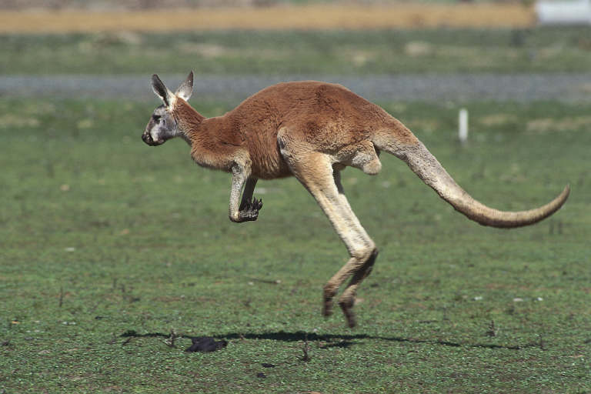
I am a Kangaroo By Kadynn R.
I am a kangaroo in Australia.
I am a very energetic kangaroo who hopes all around.
I like to annoy my siblings because I know when they are near.
I sometimes get worn out from hopping all day, and sit and do nothing.
I am an athlete because a kangaroo likes to run and play.
I am caring for my friends and family because a kangaroo likes to protect their joey.
That’s why I am a kangaroo.

Slide 20
I am Pop Music By Gabby R.
When I am mad and I want to scream, I am a loud song.
When I am at school peacefully doing my work, I am a soft happy song.
When I am crafting unique items, I am a fascinating song.
When I am watching melancholy movies, I am a heart wrenching song.
I move like the beat, I am an upbeat song.
I am pop music.

Slide 21
I am a Monkey By Leo O.
I am an energetic monkey when I’m playing football with my best friends.
I am a monkey climbing trees when I’m bored outside.
When it’s recess time, I am a hyper monkey after he’s eaten a bunch of bananas.
I am a monkey climbing and swinging in the trees.
I am a silly monkey who makes people laugh a lot.

Slide 22
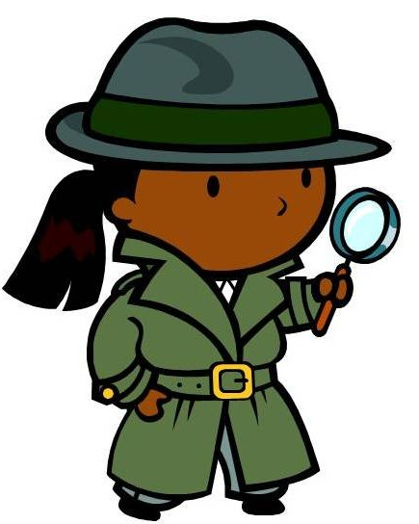
I am a Detective By Violet T.
I’m a detective reading clues when I read books.
I’m a detective figuring out how my toys get broken.
I am a detective solving problems like in math.
I’m a detective finding notes like poems and stories.
I am a detective finding out who bought the new Christmas decoration.
I am a detective learning about people I don’t know.

Slide 23
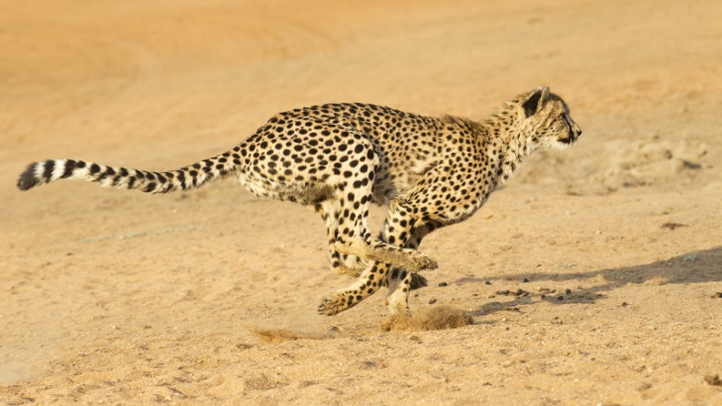
I am a Cheetah By Nathan D.
I am a cheetah playing hide-and-go-seek with my enemies.
I am a hungry cheetah furiously looking for meat.
I am a father cheetah who cares for his babies.
During a game of tag, I am a cheetah running after its prey.
I am a cheetah that is very sleepy from a long day of running.
I am a cheetah who roars to scare my enemies away.
I’m a cheetah that jumps to get my food.

